Slide 1

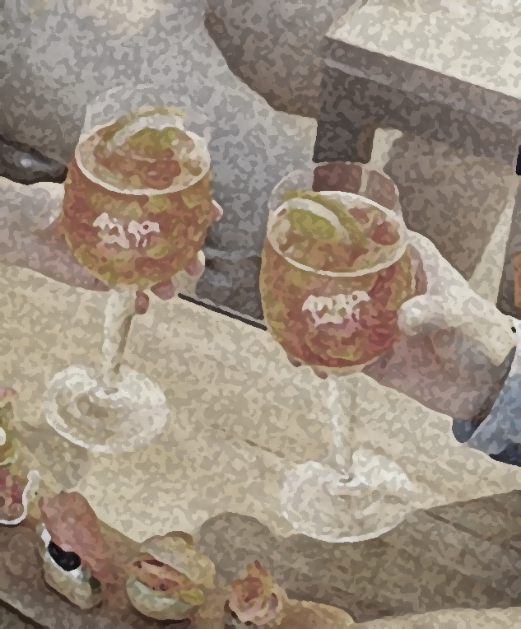


Alcohol-related tweets in Australian Cities
--Analytics on the cloud
Team 05

Slide 2
We have a cooperative team
Cooperative parts: architecture and system design, topic & scenarios, general problem solving, report
Personal responsibilities:
Member | Student ID | Responsibilities
Ruiqi Zhu | 939162 | MapReduce; Data process and analysis
Zhengyang Li | 952972 | Ansible for web server/harvester/data analysis module; Web server; Harvester-search API; Videos
Jianxin Xu | 1014840 | Web-based Design and Visualization
Qiuxia YIN | 1017231 | Instances &CouchDB cluster; one-key deployment; Aurin data
Fang Qu | 1070888 | Harvester-stream API; Database backup and merge
Notes:
From a water treatment specialist's blog: 4 Ways That Weather Can Affect the Water Quality in Your Home: 1. Rainfall;2.Drought; 3. Hot Weather;4. Cold Weather;

Slide 3
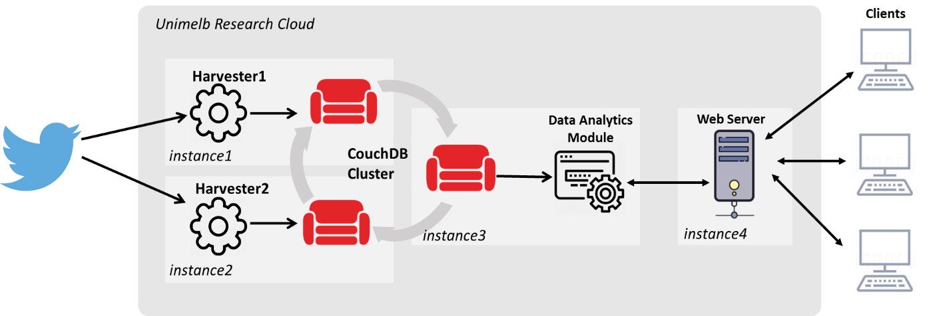
Architecture: a scalable system

Slide 4
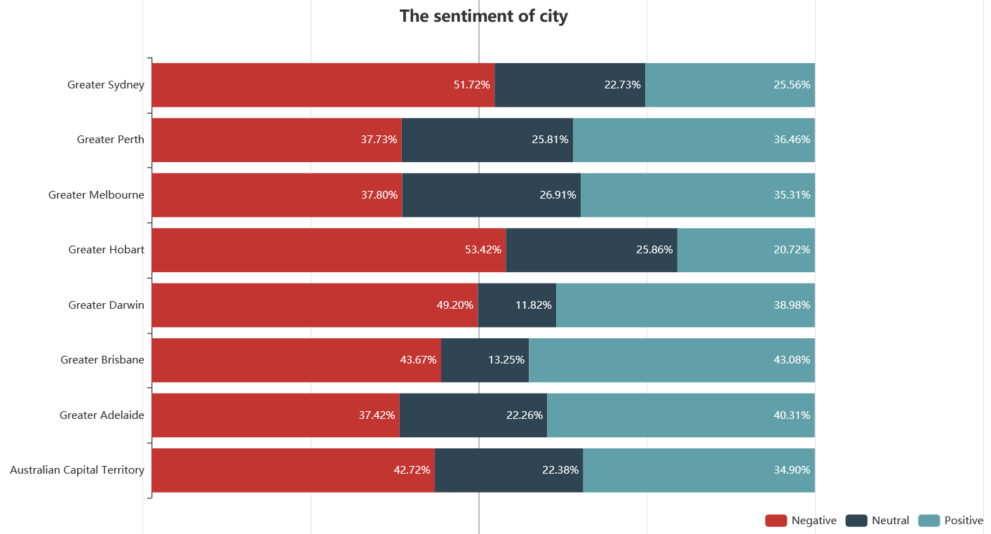
Alcohol tweets—Big Cities
可以把城市人口分布的图放在右边

Slide 5
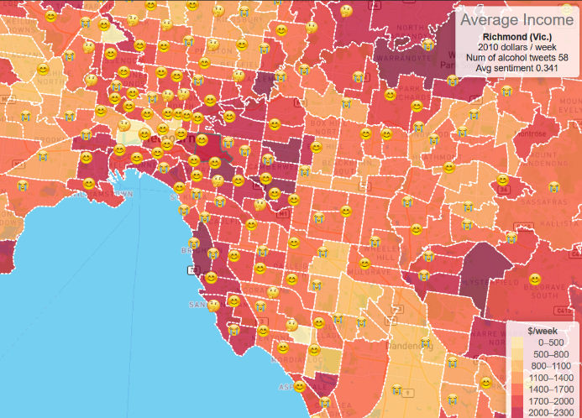
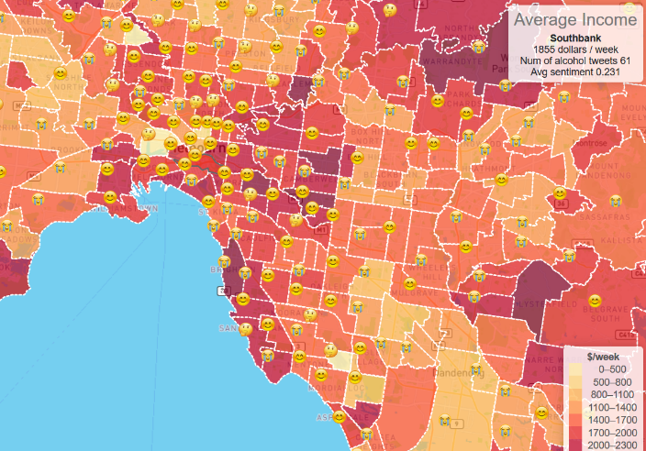

Any difference in Melbourne suburbs?
Richmond
Southbank
Braeside
Next: Live Demo

